Slide 1
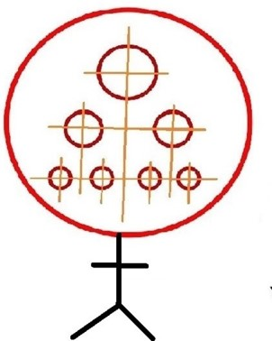
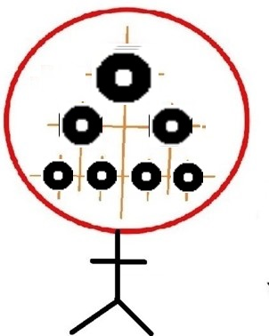
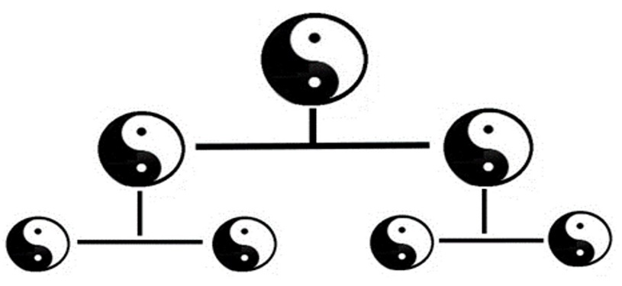
Hello, dear Thinkers about Thinking!
We are continuing 2nd part «SYSTEMIC THINKING –
ABC of Systems Theories»
of our study course as well as corresponding research project.
Second chapter : CONSTRUCTION
of the SYSTEMS – HIERARCHY
OF SYSTEMS STRUCTURES
All systems are theoretical
representations of different phenomena of the Universe within the Humans brain
Study week No 6

Slide 2
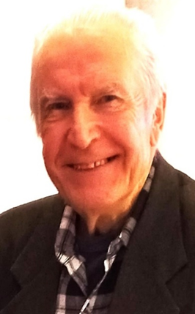
University of Latvia
Prof. emeritus
ANDRIS BROKS
Elective study course
«SYSTEMOLOGY
OF THINKING»
andris.broks@lu.lv https://blogi.lu.lv/broks/
ST(2)23-24 Academic year 2023-2024 2nd semester
Study week No6 : CONSTRUCTION OF THE SYSTEMS – HIERARCHICAL STRUCTURES OF THE SYSTEMS
(ABC of Systems Theories – B )
15.03.24 – 22.03.24

Slide 3
Structure of our study course «Systemology of Thinking»
1st part
WORLD OF THOUGHTS
1st chapter
Thoughts and Thinking
2nd chapter--
Transmission of Thoughts
3rd chapter -–
Arrangement of the World of Thoughts
2nd part
3rd part
SYSTEMIC THINKING
(general and particular
systems theories)
SYSTEMS THEORIES
IN PRACICE
Human, Life, Society
as systems.
SYSTEMOLOGY of
State, Research, Education, Global life
1st chapter-
SYSTEMS,
general properties
of systems
2nd chapter-
CONSTRUCTION of systems,
HIERARCHY OF SYSTEMS STRUCTURES
3rd chapter-
CHANGES
of systems, CAUSE and EFFECT chain RELATIONSHIPS
INTRODUCTION CONCLUSION

Slide 4
Let’s start
our distance meeting -
stage No1
Remarks on selected top level concepts of the course,
that were considered during the previos week of studies

Slide 5
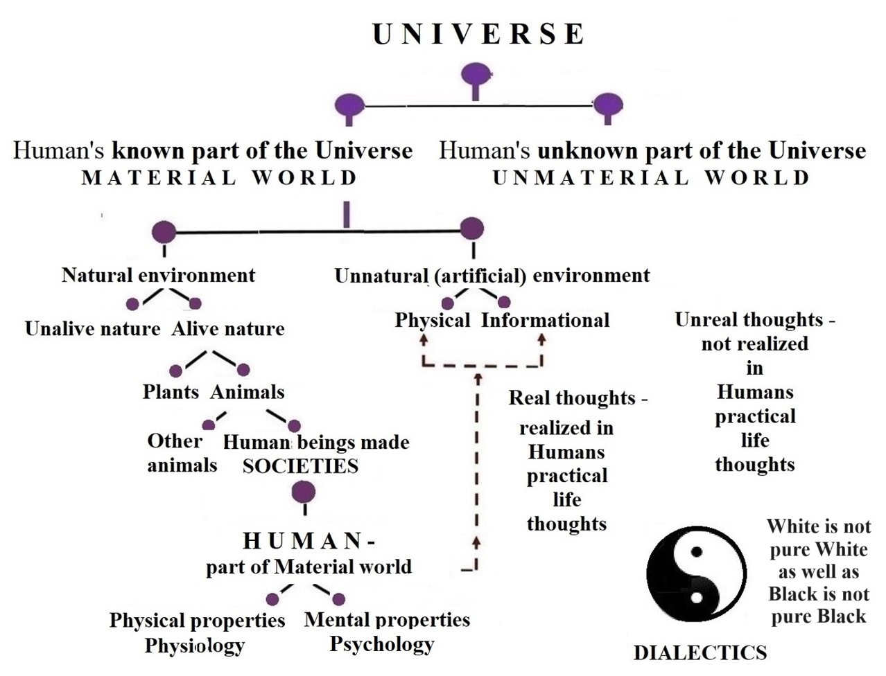
H U M A N ’ S L I F E
within the U N I V E R S E
UNIVERSE - it is a set
of diverse Phenomena
as Changing Things.
LIFE - it is a set of diverse humans’ activities to satisfy their needs of Life.
It’s continous everyday meeting with something known and unknown!
HUMAN as Homo
Sapiens – it is the conscious alive (living) being.

Slide 6
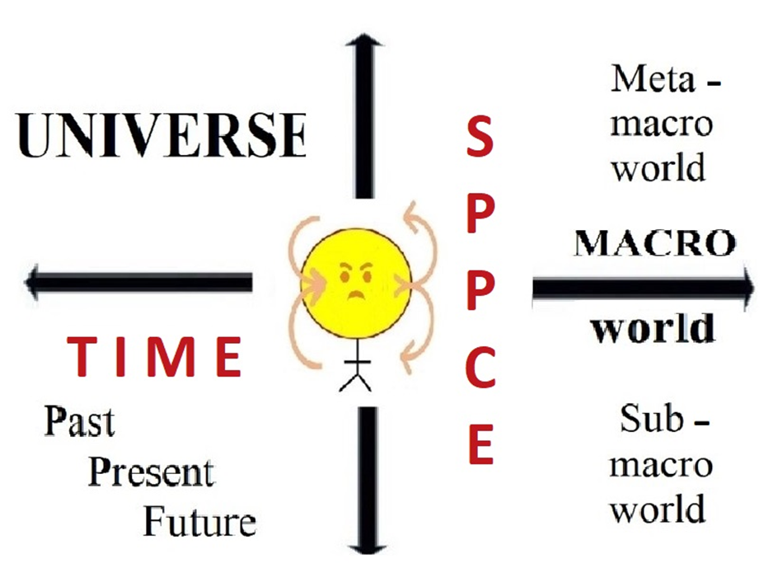
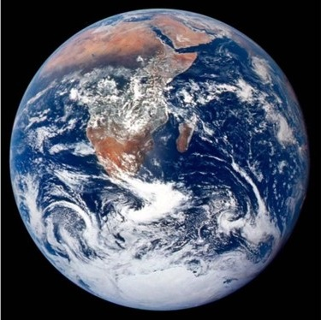
All phenomena of the Universe are represented
in the World of Human’s Thoughts as changing things that are interconnected and interacting in Space and Time
SPACE-TIME
CROSS –
the most important
dialectical
Thoughts structure
Me as a HUMAN - part of the Universe: here (in space) and now (in time)

Slide 7
The ARRANGEMENT of the Human’s World of Thoughts
is described (modelled) by corresponding spatial and
time-changing STRUCTURES of Thoughts and Thinking
The mutual arrangement of thoughts as things in SPACE
is characterized by time-invariant
static and time-changing STRUCTURES
The arrangement of thinking as processing of Thoughts in TIME means arrangement of the time-consecutive change of thoughts
It is also characterized by time-invariant
static and time-changing STRUCTURES

Slide 8
The World of Human’s Thoughts as representation of the Universe is an arranged set of interconnected small and big thoughts

Slide 9
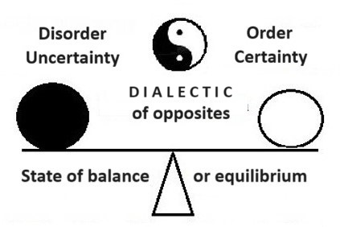
ARRANGEMENT of the World of Human’s Thoughts
in space and time IS CHANGING.
A changing balance of order and disorder
(proportion) exists
ORDER –
perfect or ideal
ARRANGEENT,
which has never
been observed
anywhere in
practice, –
it means
UNREALITY
DISORDER –
perfect or ideal
CHAOS,
which has never
been observed
anywhere in
practice, –
it means
UNREALITY
In practice, random fluctuations
around a variable state of equilibrium are really observed

Slide 10
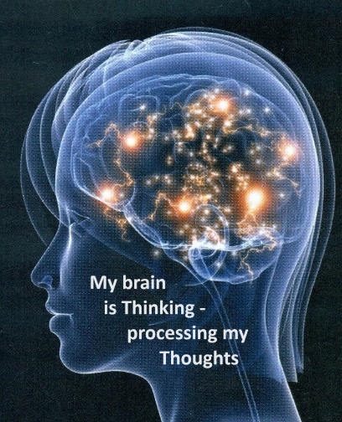
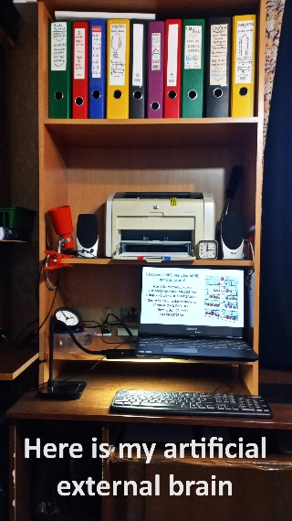
IT’S TIME TO GENERALIZE the concept of arrangement
of Thoughts to everything what Humans percept as parts of the Universe – changing Things.
Human's World of Thoughts by nature is the copy of the Universe as a set of corresponding phenomena

Slide 11
S Y S T E M S are universal representation of the Universe within the Human’s brain) is a natural copy of corresponding phenomena of the Universe
This representation as a set of different theories ( models, descriptions, etc.) is arranged in space and time by parts, comparing and connecting them
within the WHOLE
Different people,
different groups of people, societies – different
WORLDS OF THOUGHTS.
But this diversity have the unifying general core of principles, what is the same for all particular situations.

Slide 12
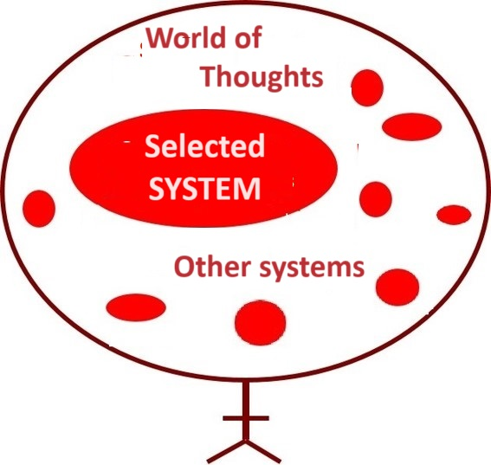
Each phenomenon of the Universe is reflected (physiology) and represented (psychology) within the Human’s brain as the SYSTEM.
What does it mean the word «SYSTEM» ?
Word SYSTEM means everything as the WHOLE, what conteins interactive parts and at the same time is the PART as subsystem of some other bigger System

Slide 13
Systemic (systems) or arranged Thinking –
it’s mental or spiritual
brain activity of Human
World
of Thoughts
SYSTEM
Other
systems
All material world’s phenomena are represented within Human’s World of Thoughts as SYSTEMS
Internal
interacting parts of the system
SYSTEM – it is the whole, what contains interconnected parts (inner environment of the system)
and what is surrounded by other systems
(outer environment of the system)
External environment of the system
SYSTEM’S
properties
Causality of everything
means effect-cause chain relationships because of interaction of everything
Cognition
Behaviour
External Material World of the Human

Slide 14
SYSTEMIC THINKING – it means the process of arranging PARTS of every phenomenon in the Universe as the SYSTEM - the WHOLE, that contains interactive PARTS and what
is the PART within the other systems - BIGGER WHOLES.
DIALECTIC multilevel (hierachic)cal) structure of SYSTEM
as the WHOLE what is made by two different interconnected internal PARTS as well as being PARTS within the bigger WHOULES.

Slide 15
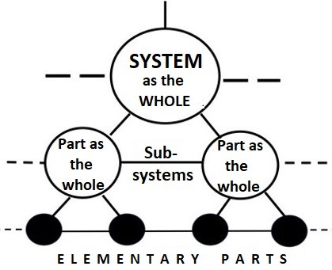
General orTop concepts of all SYSTEMS THEORIES
Word SYSTEM means everything as the WHOLE, what conteins interactive parts and at the same time is the PART as subsystem of some other bigger System
Arranged or systemic reflection of the Universe is realized by PARTS (ANALYSIS), comparing and connecting them (SYNTHESIS) within the WHOLE (SYSTEM).
HIERARCHY of systems structures

Slide 16
SYSTEMIC thinking – it means human’s THINKING
as arranging or systemic representation of the Universe
within the Human’s WORLD OF THOUGHTS
Systems theory as
GENERAL SYSTEMS THEORY
Is the top level theory above all particular or applied systems theories
SYSTEMOLOGY is particular or applied systems theory about ARRANGEMENT of human’s SELECTED PHENOMENA OF THE UNIVERSE
SYSTEMS THEORY
systemologies

Slide 17
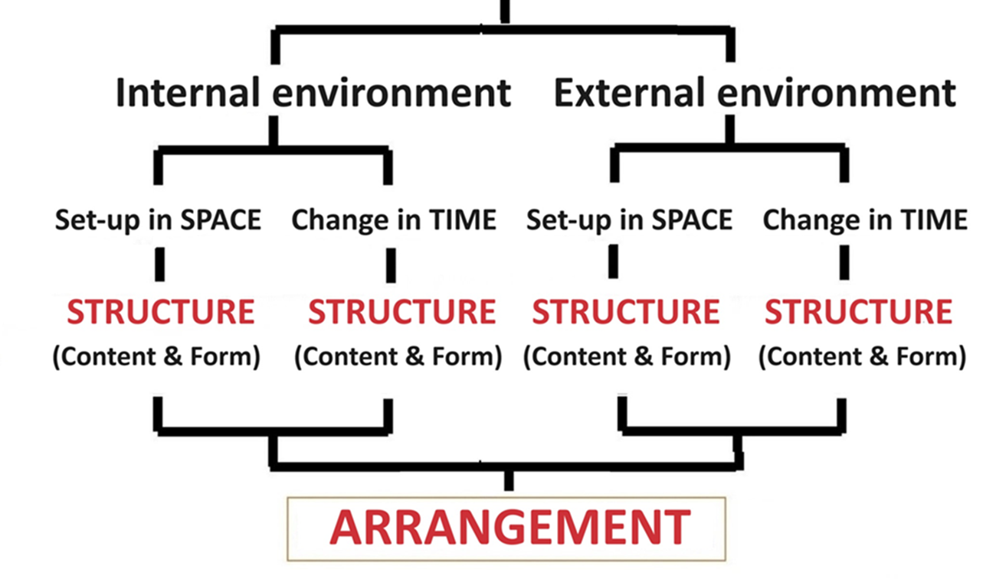
GENERAL (universal for all systems)
properties of everyTHING as the SYSTEM
(someTHING as the whole and at the same time
also as the part of something else as the WHOLE)

Slide 18
A T T E N T I O N !
Every system’s top level property is
internal and external environment of the system!
In practice , concentrating on selected particular phenomena, people are very often forget to take care of systems external environment!
Let’s be very carefull with isolated systems!

Slide 19
Let’s continue
our distance meeting -
stage No2
Now it is last time to send QUESTIONS
for interactive SEMINAR,
what follows just after this
LECTURE

Slide 20
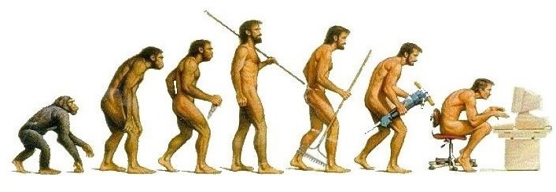
What are your QUESTIONS, SUGGESTIONS?
Please write them in the "chat" section of computer-based communication - we will discuss them after the lecture!

Slide 21
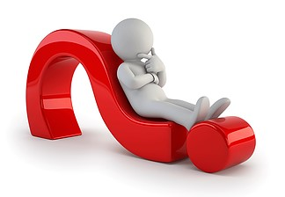
My selfcontrol question again to everybody of us : what ARE YOUR FEELINGS after five weeks period of independently creative thinking about your Thinking?
Have you got any new impressions, are you feeling any initial satisfaction of Systemic Thinking about Systemic Thinking in your daily life?

Slide 22
Let’s continue
our distance meeting -
stage No3
2nd part, 2nd chapter
CONSTRUCTION of SYSTEMS,
HIERARCHY OF SYSTEMS STRUCTURES

Slide 23
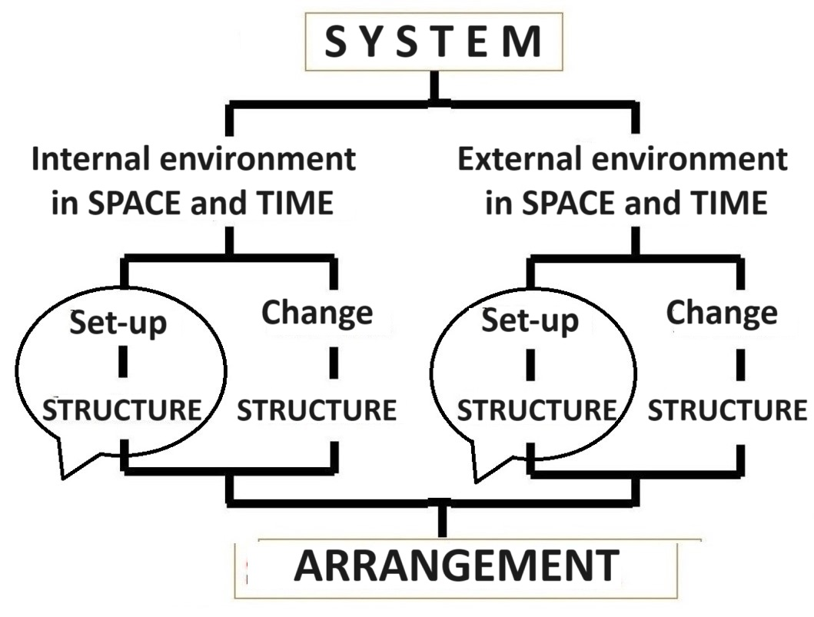
The representation of the diverse phenomena of the universe in the world of human thoughts is formed in an orderly or systemic manner - how to organize the wholes of thoughts corresponding to these diverse phenomena - S I S T E M A S
We will devote this study week to awear the arrangenent (orderliness) or systemism of thoughts, paying special attention
to the spatial structures of the Human's world of Thoughts.
The representation of the diverse phenomena of the Universe within the Human’s World of Thoughts is formed in an orderly or arraged or systemic manner -
organizing the SYSTEMS as the Wholes of Thoughts, what correspond to diverse phenomena of the Universe.-

Slide 24
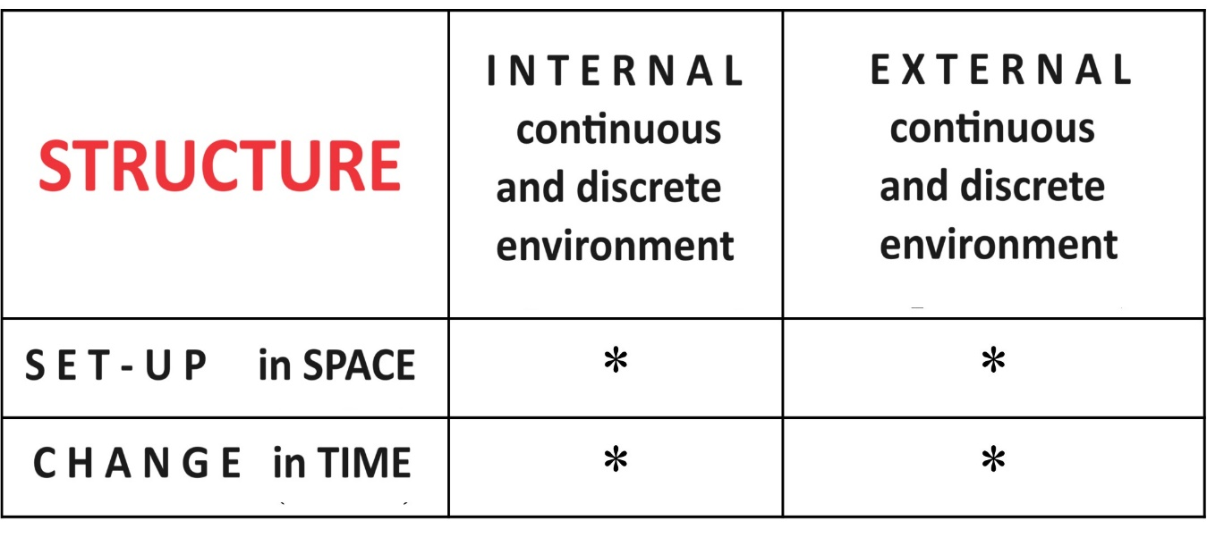
S T R U C T U R E – it is a general top level property of any SYSTEM what characterize the mutual arrangement
of PARTS within the WHOLE in SPACE and TIME.

Slide 25
Systems structures can be effectively visualized by corresponding MIND MAPS
Drawing these maps as two-dimensional structures we are visualizing the horizontal and vertical interconnections of thoughts as systems that form multilevel or hierarchical structures.
Vertical interconnections visualizes mutually subordinated thoughts, whose relations are characterized by vertical lines. In such a relationship there are general and particular thoughts.
Horizontal interconnections visualizes mutually complementary thoughts, the relationships of which are characterized by horizontal lines. In such a relationship one level thoughts exists.

Slide 26
Mathematical modeling of the set of phenomena of the Universe
Every FORMAL STRUCTURE of the systems theories comes from the top science of formal thinking - MATHEMATICS. Namely, these structures are geometric structures formed by points and lines interconnecting them. For example, vertical and horizontal space-oriented line segments, polygons (squares, trapezoids), etc. geometrical figures.
By attaching things-thoughts-words to each point, the formal mathematical structure is filled with real content and CONTENT STRUCTURES of the system of interest to people arise.
The interconnectedness of changing things as phenomena of the Universe and -thoughts-words within the Humanš brain are represented by the lines connecting the endpoints of the lines. So, filled by real content STRUCTURE of every phenomenon as a SYSTEM can be also vizualized in drawings, including corresponding Mind maps.

Slide 27
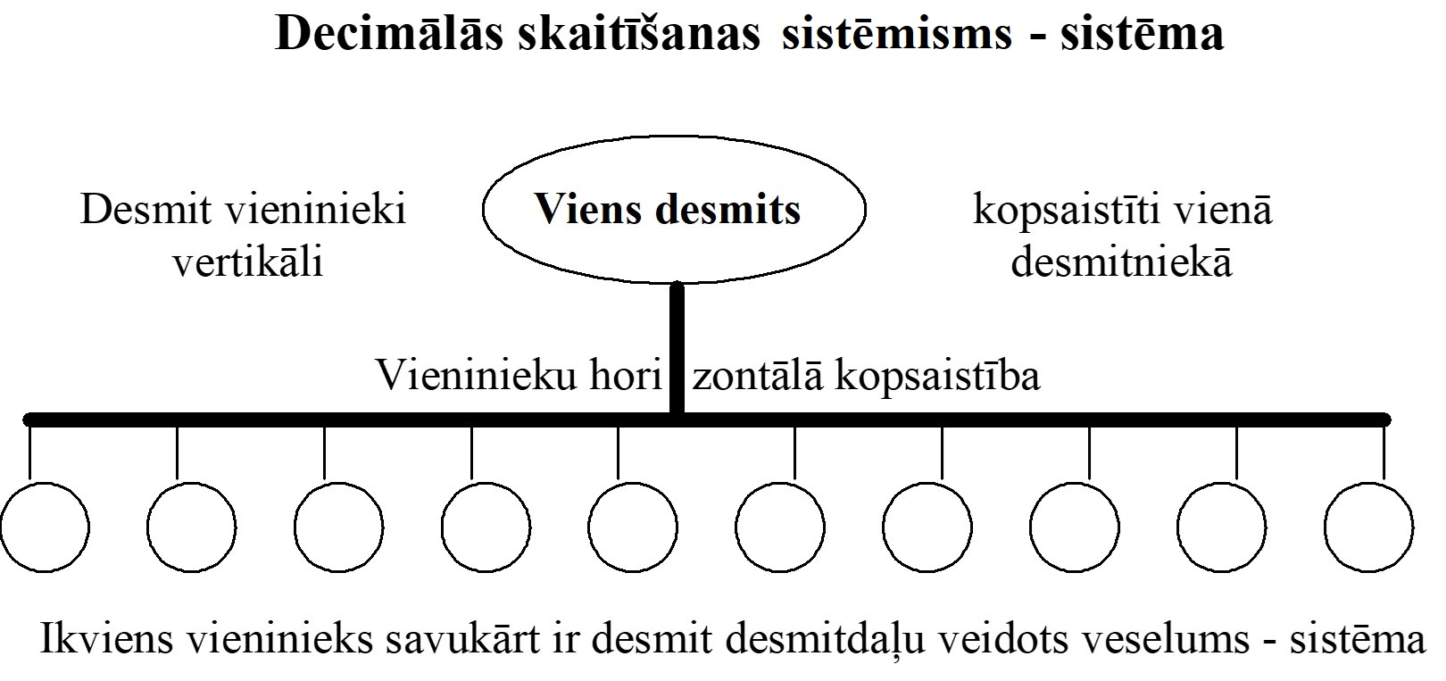
Lielisku vispārīgu piemēru veselo un daļu attiecību hierarhijai sniedz matemātika, veidojot dažādas skaitīšanas sistēmas

Slide 29
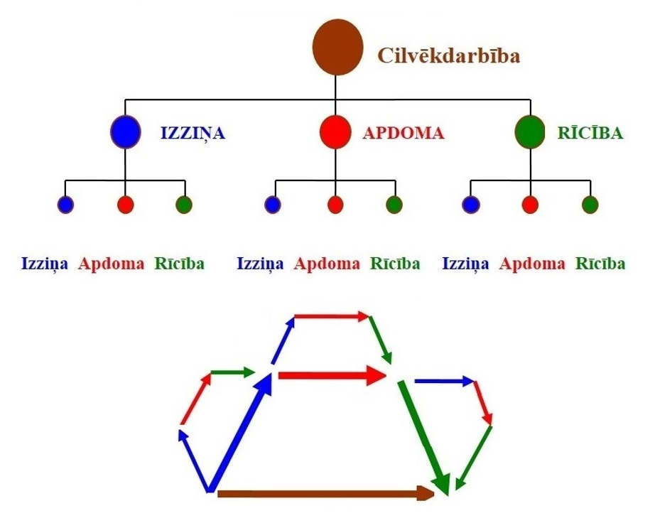
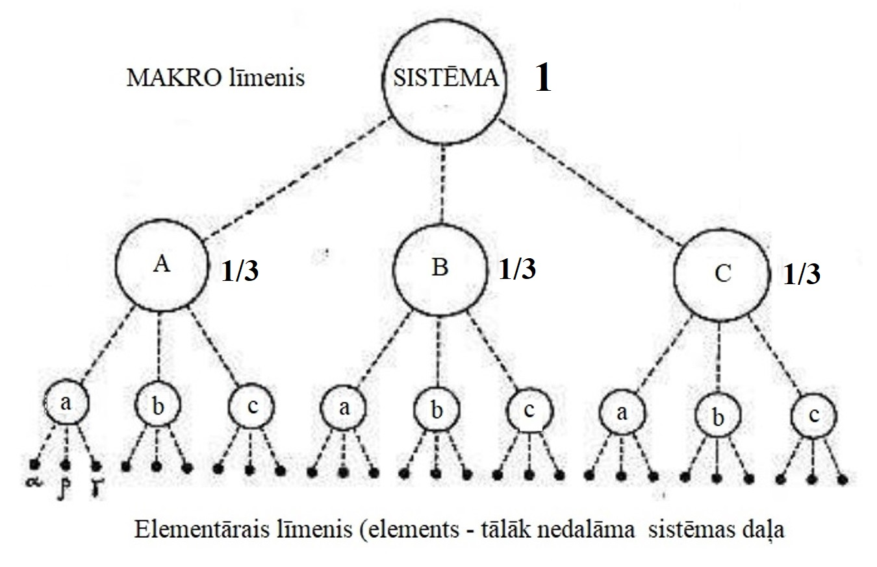
TRIALEKTIKA
Trialektiskā sistēmiskā domāšana
(trialektisko sistēmu struktūru hierarhija)

Slide 30
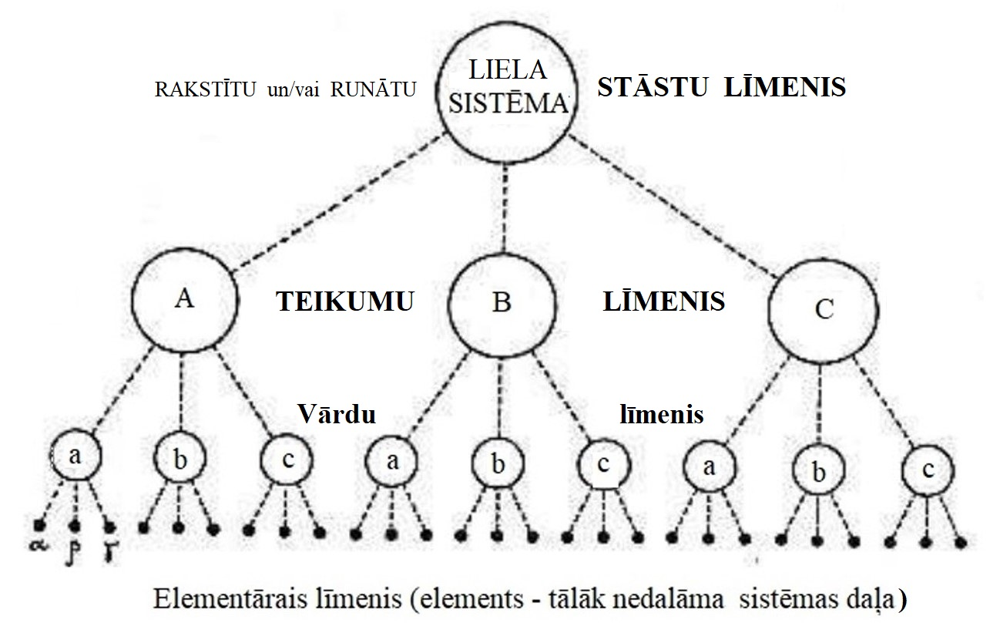
Lielisku vispārīgu piemēru veselo un daļu attiecību hierarhijai sniedz arī literārās jeb vārdiskās valodas, kas ir dažādu alfabēta burtu kā cilvēku saziņas elementāro zīmju veidotas struktūras –SISTĒMAS
Elementārās rakstu zīmes - alfabēta burti kā vārdiskās saziņas
rakstisko valodu pamatu pamats
Elementārās skaņas kā elementārās cilvēku sarunvalodu zīmes kopsaustībā ar atbilstošajām rakstiskās vārdiskās saziņas burtiem

Slide 31
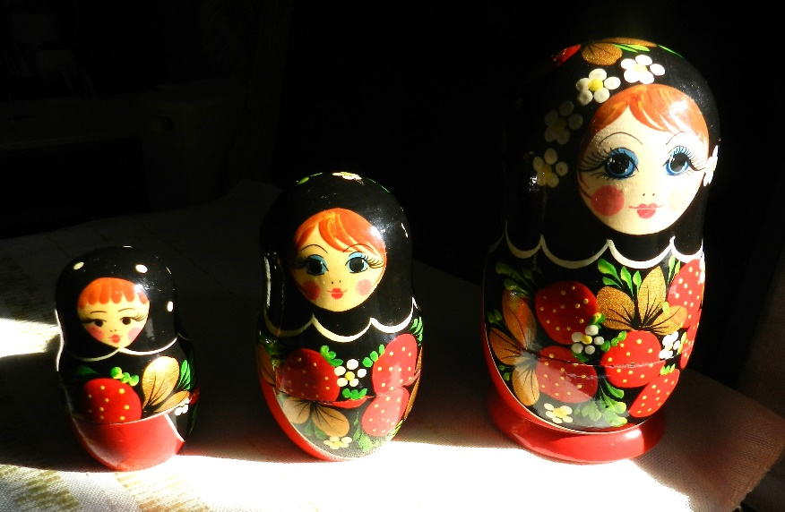
Hierarchical structures of the systems -
discoveries of the arrangement of things in our childhood!

Slide 32
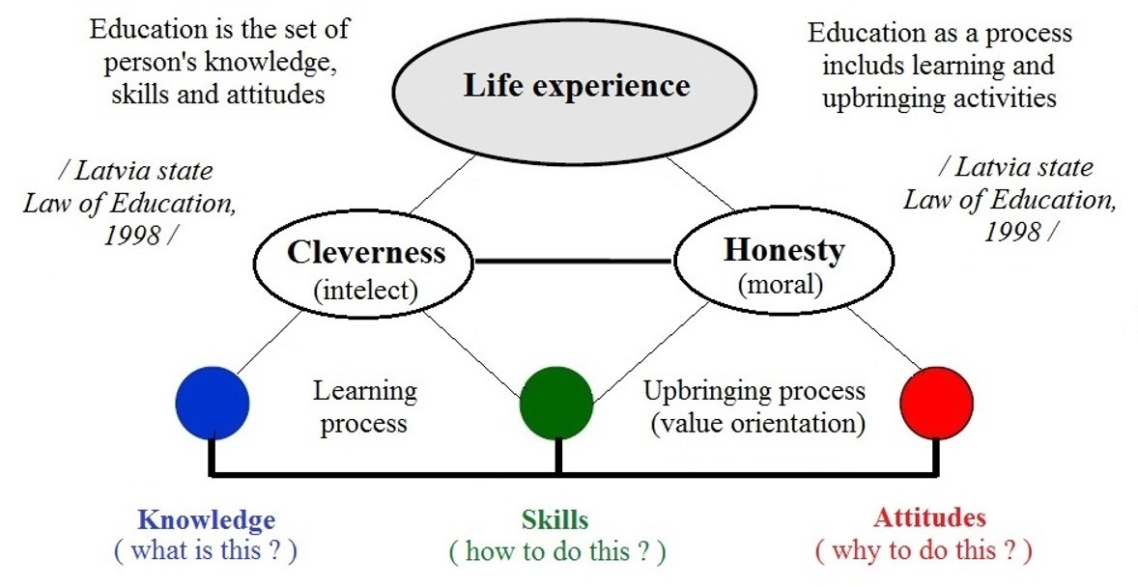
Systemic structure of Education as Life experience for Life

Slide 34
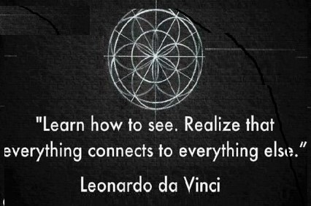

Slide 35
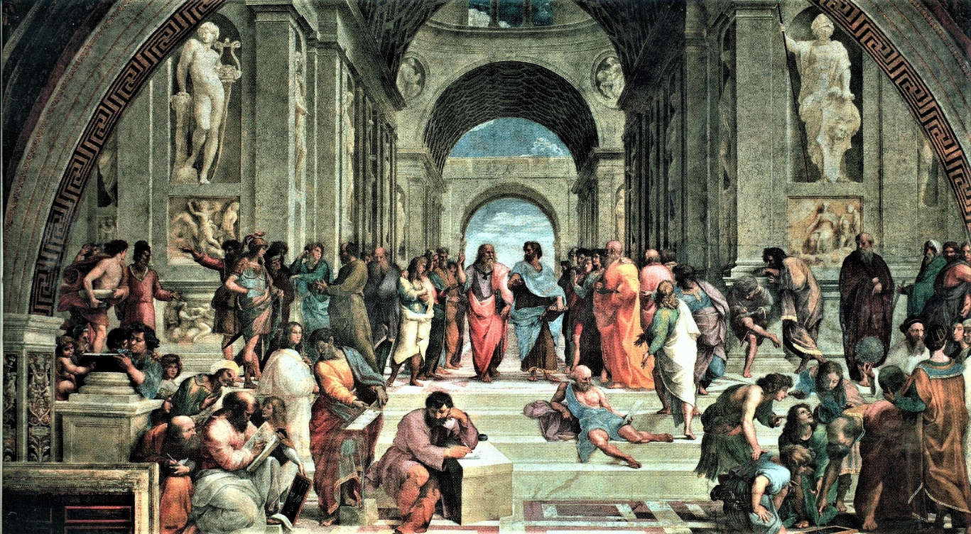
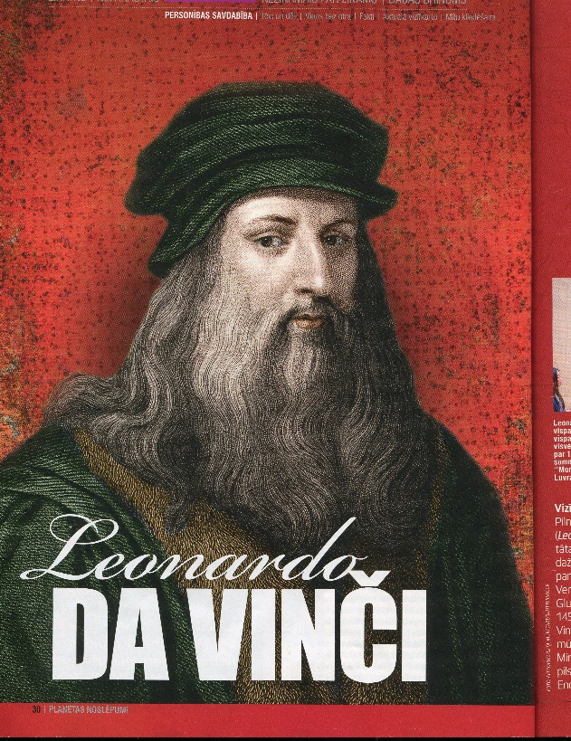
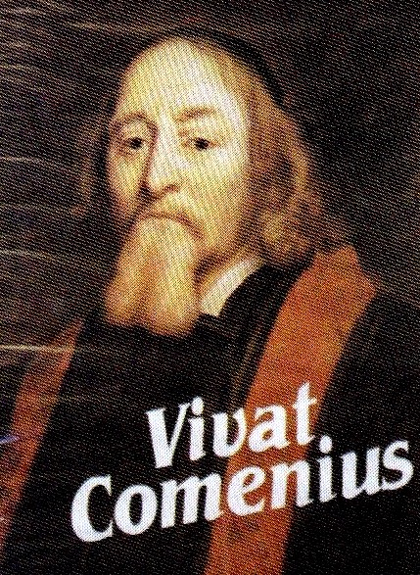
Everything is new,
what has been
forgotten!

Slide 36
SYSTEMIC THINKING
is the backbone of conscious thinking for modern scientific as well as artistic and pragmatic
EDUCATION for tomorrow!
SYSTEMS are models of the phenomena what are all around us and within us – such is represenation of the UNIVERSE within our WORLD OF THOUGTS
as our brainware for our LIFE

Slide 37
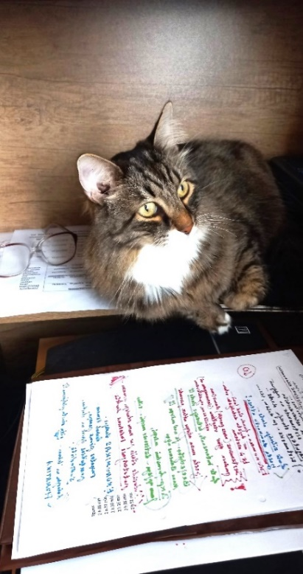
Let me wish
to all of you successful independently creative study week No 6
Materials for study week No6 06_ST(2)23-24 engl 15.03/24 are here: https://failiem.lv/u/awmf83xyb7
See you again on next Friday, 22.03.24 afternoon (16:30 –18:30)
We will continue 2nd part of our course «SYSTEMIC THINKING –
general and particular systems theories» Secondt chapter : CHANGES of Systems - time-changing structures : cause – effect chain relationships and univesal concept of interaction of everytging.

